Slide 1
EE4204 Socket Programming Assignment and Example Programs
Graduate Assistants: Kang Zhenyu and Anum Talpur
Sivaraman Vignesh (Ex-Graduate Assistant)
Module Lecturer: Assoc. Prof. Mohan Gurusamy
Electrical and Computer Engineering Department
National University of Singapore

Slide 2
What is socket?
Used to do communication between two processes running on two different machines
An object (special file) which acts as an end point between two machines
Request
P
O
R
T
P
O
R
T
IP Address
IP
Address
Client
Server
Response
Socket | IP_Address:Port (Ex: 127.0.0.1:4950)

Slide 3
Sockets
Application Programming Interface (API)
Interface between an application and network
Application creates a socket
The interface defines the following operations
Create a socket
Attach a socket to the network
Send/receive messages through a socket
Close a socket
Notes:
Sockets are programming channels for processes to exchange data locally and across the network.
A socket is an end point of a two-way communication channel.

Slide 4
Example 1
Develop a socket program in UNIX/Linux that uses (i) TCP as the transport protocol and (ii) UDP as the transport protocol for transferring a short message between a client and server. The client sends a string (input by the user) to the server and the server prints the string on the screen after receiving it.
Notes:
TCP- connection oriented, slow, reliable
UDP- connectionless, faster, unreliable

Slide 5
UDP (Connectionless)
Server
client
Create socket
Bind
ReceiveFrom
Create socket
SendTo
Notes:
Create socket
Bind socket and its address parameters
Receives data from a specific socket.
Sends data to a specific socket.

Slide 6
UDP
Socket()
bind()
recv()
close socket
Socket()
send()
close socket

Slide 7
UDP (Connectionless)
Server
client
Create socket
Bind
ReceiveFrom
Create socket
SendTo
Notes:
Create socket
Bind socket and its address parameters
Receives data from a specific socket.
Sends data to a specific socket.

Slide 8
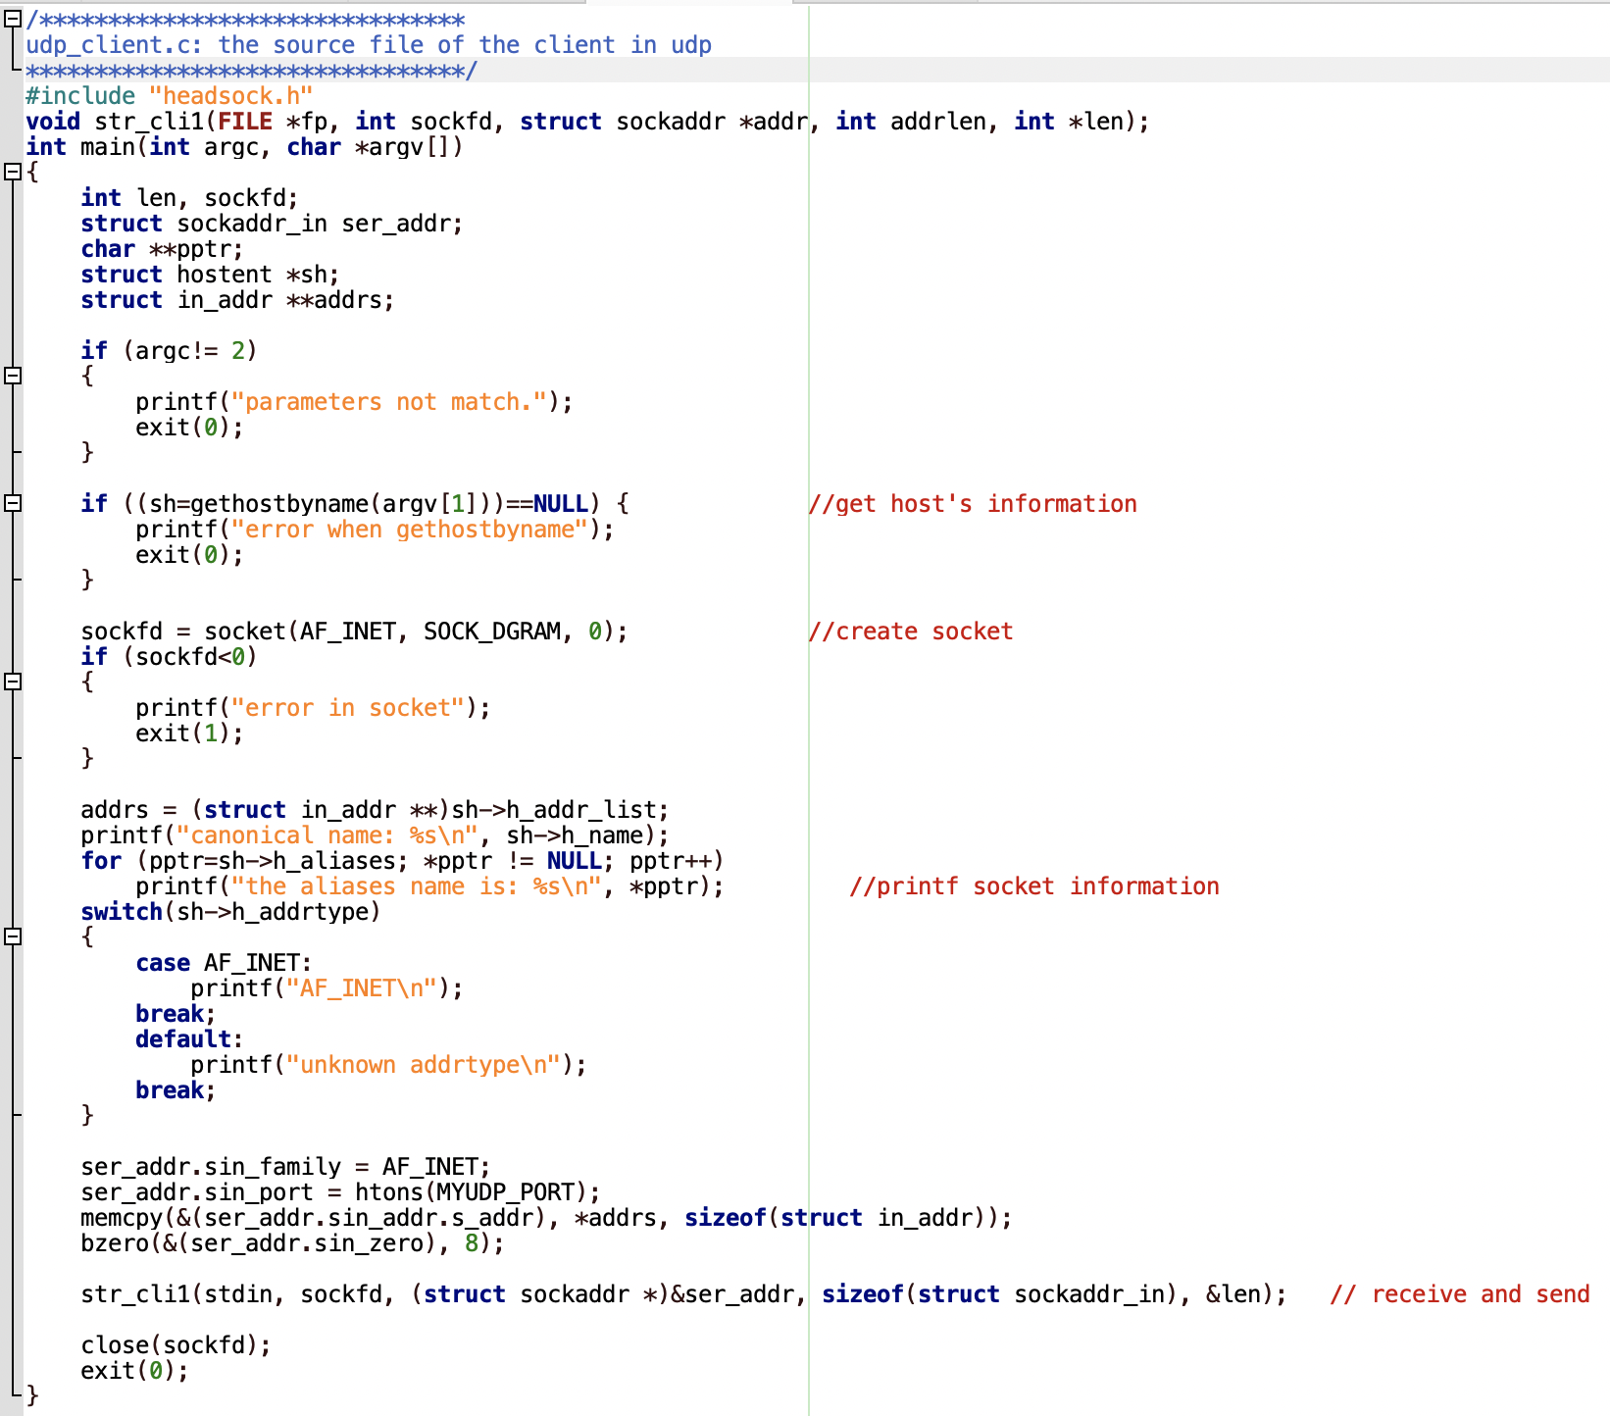
Client

Slide 9
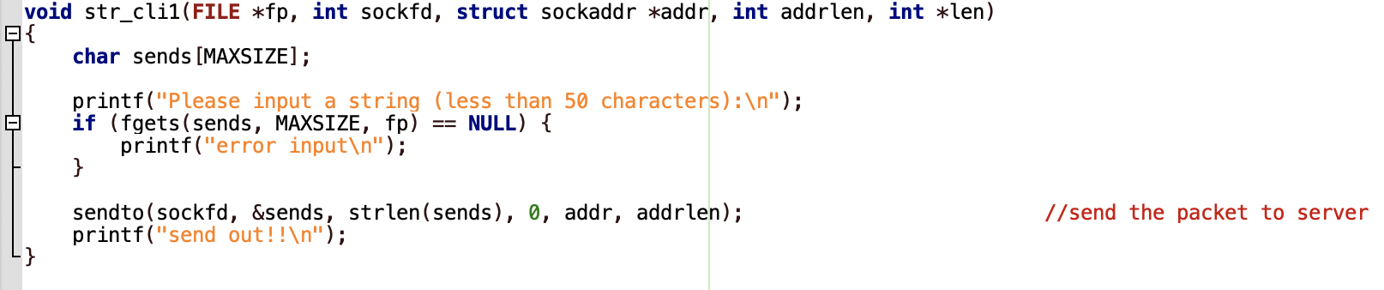
Client
(conti:)

Slide 10
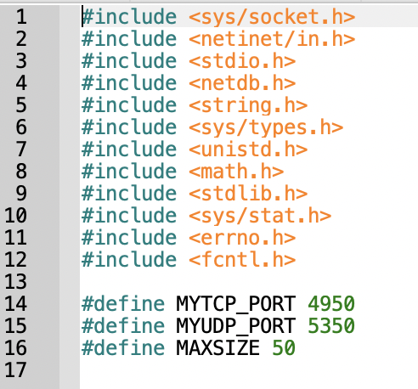
Header file

Slide 11
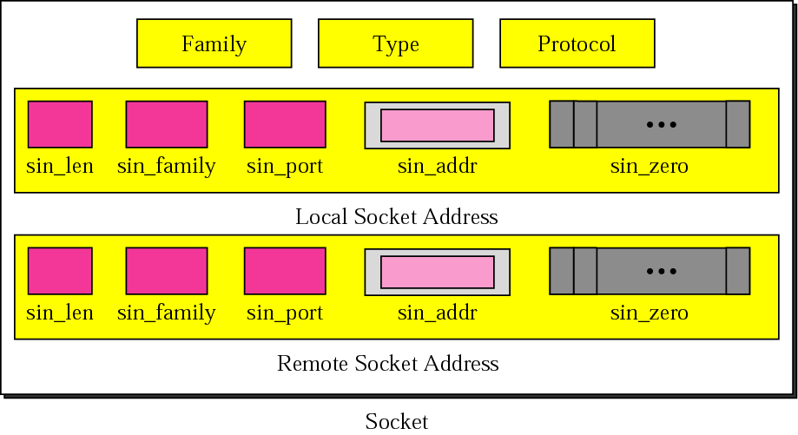
Socket structure
© The McGraw-Hill Companies, Inc., 2000
Notes:
Sin_zero : append zeros
1. the protocol family is always AF_INET for the TCP/IP protocol suite.
2. the type specifies whether this is a stream or datagram socket
3. the protocol specifies either TCP or UDP.

Slide 12
Socket – Family and Type
Socket Family
AF_INET : Internet Family
AF_UNIX: Unix Pipe facility
Socket Type
SOCK_STREAM: byte stream such as TCP
SOCK_DGRAM: message oriented service such as UDP
Protocol
Specifies either TCP or UDP
‘Zero’
Notes:
The reason that both type and protocol need to be specified is to allow additional transport-level protocols to be included in a future implementation.

Slide 13
UDP Client
Create a socket
© The McGraw-Hill Companies, Inc., 2000
Notes:
Create socket
Bind socket and its address parameters
Receives data from a specific socket.
Sends data to a specific socket.

Slide 14
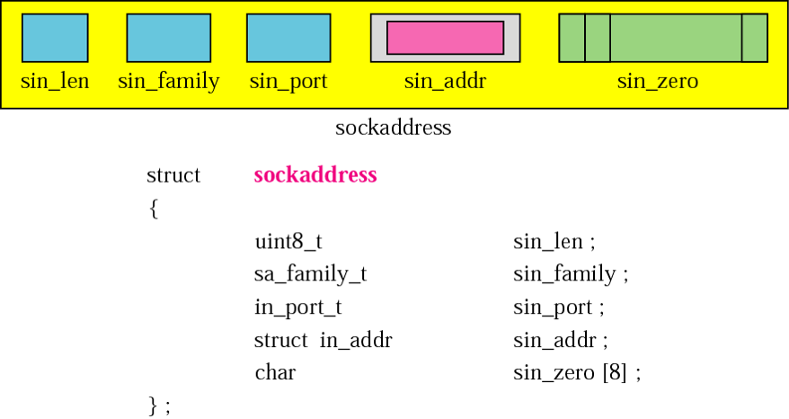
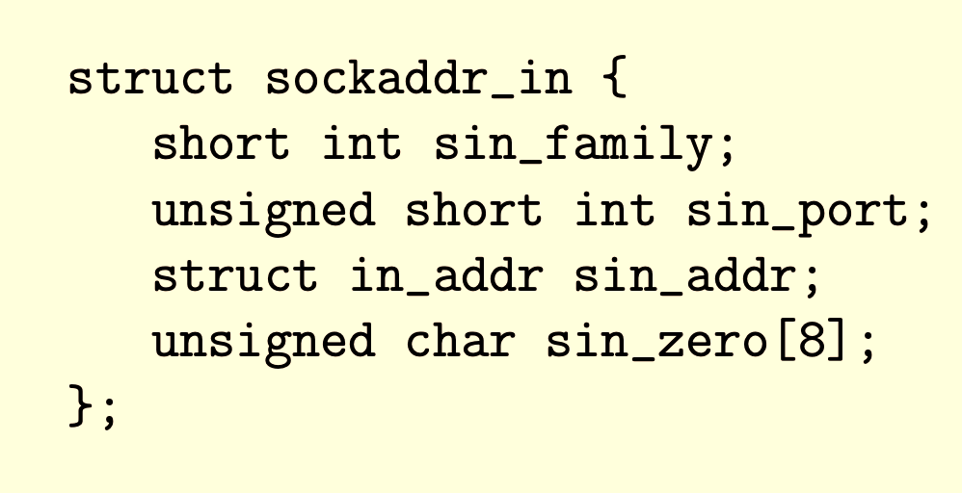
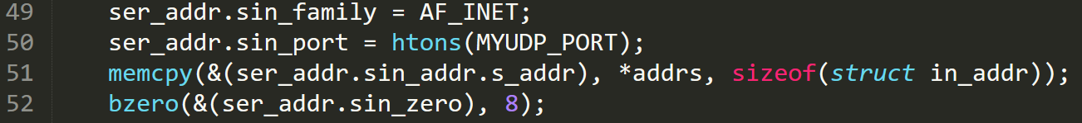
UDP Client
© The McGraw-Hill Companies, Inc., 2000
Get the server address
Has information like name,
aliases, address type etc
Send data to the server
Server address(remote socket)
Notes:
Create socket
Bind socket and its address parameters
Receives data from a specific socket.
Sends data to a specific socket.
Memcpy: copy data from src tp dest
The bzero function places nbyte null bytes in the string s. This function is used to set all the socket structures with null values.
The flags parameter contains control flags, typically set to 0.
struct sockaddr_in {
short int sin_family; // Address family (TCP/IP)
unsigned short int sin_port; // Port number
struct in_addr sin_addr; // Internet address
unsigned char sin_zero[8]; // Same size as struct sockaddr
};

Slide 15
UDP
Server
client
Create socket
Bind
Receivefrom
Create socket
Sendto

Slide 16
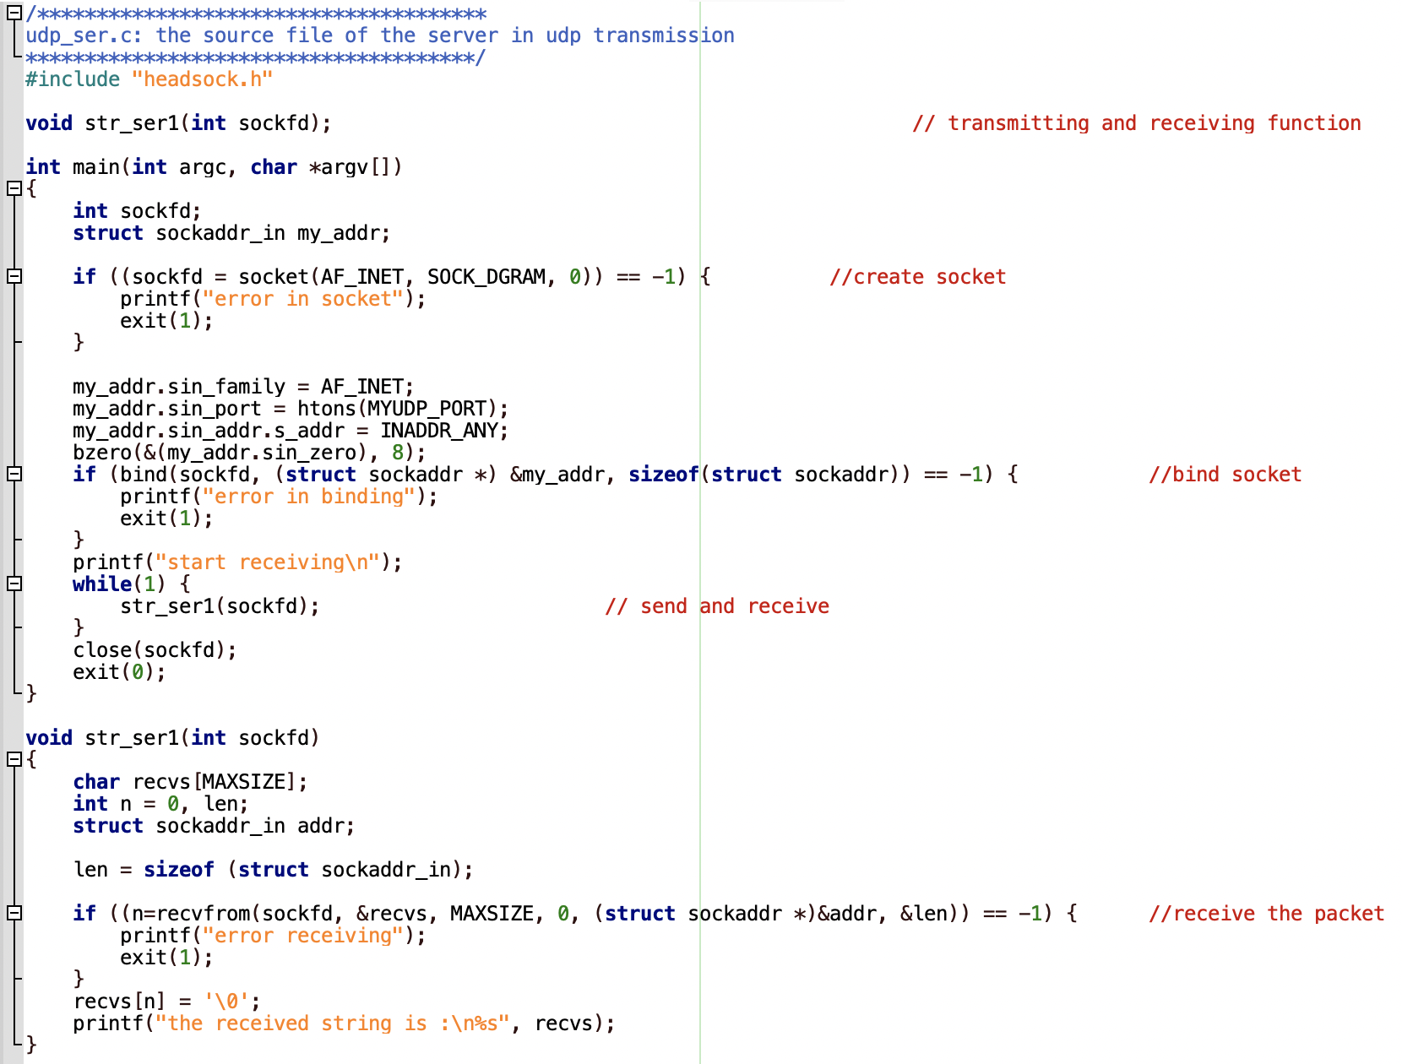

Slide 17
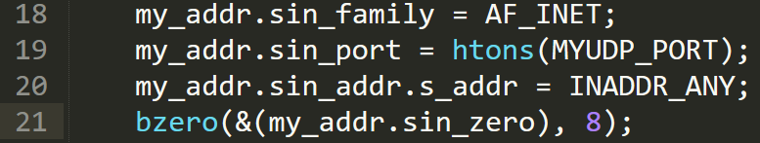
UDP Server
Creating socket is same as the client
Values of the other tuples
In case the system has multiple IPs
© The McGraw-Hill Companies, Inc., 2000

Slide 18
UDP Server
Bind function: Associates the socket with the given local address
Receive from client
Client address (remote socket)
Close the socket (both at server and client)
Notes:
Create socket
bind() associates the socket with its local address [that's why server side binds, so that clients can use that address to connect to server.
Bind socket and its address parameters
Receives data from a specific socket.
Sends data to a specific socket.

Slide 19
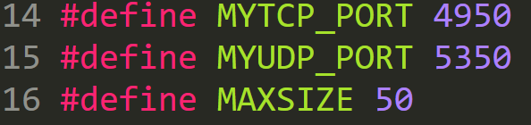
headsock.h (Ex 1)

Slide 20
TCP (Connection-oriented)
server
client
Create socket
Bind
Listen
Accept
Receive/Send
Create socket
Connect
Send/Receive
Notes:
1. Create a TCP socket using socket(). 2. Establish a connection to the server using connect(). 3. Communicate using send() and recv(). 4. Close the connection with close().

Slide 21
TCP
Socket()
bind()
accept()
listen()
recv() & send()
close socket
Socket()
connect()
send() & recv()
close socket

Slide 22
TCP
server
client
Create socket
Bind
Listen
Accept
Receive
Create socket
Connect
Send

Slide 23
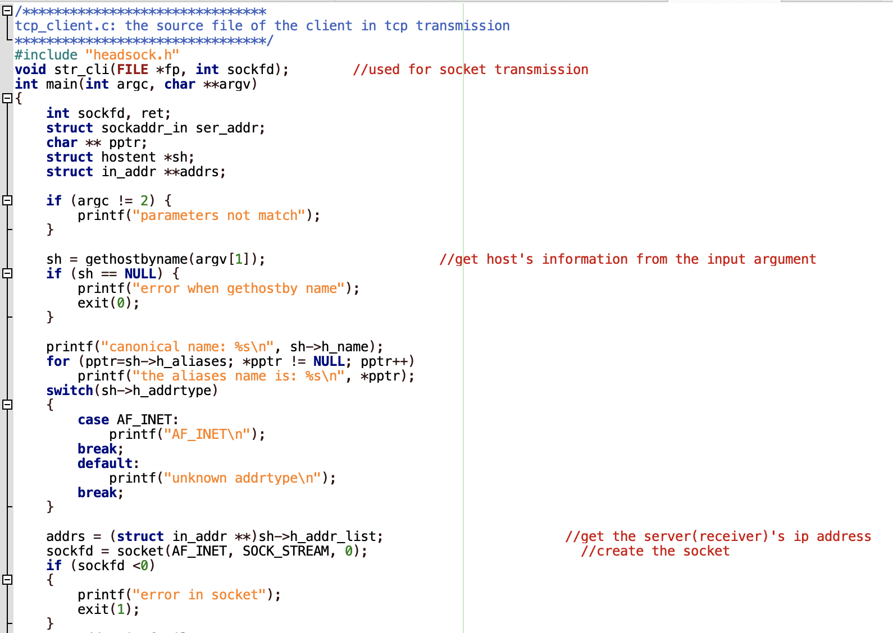

Slide 24
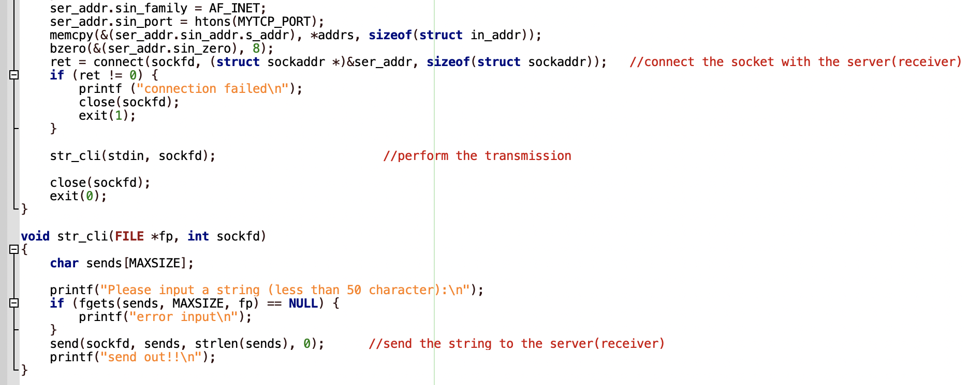

Slide 25
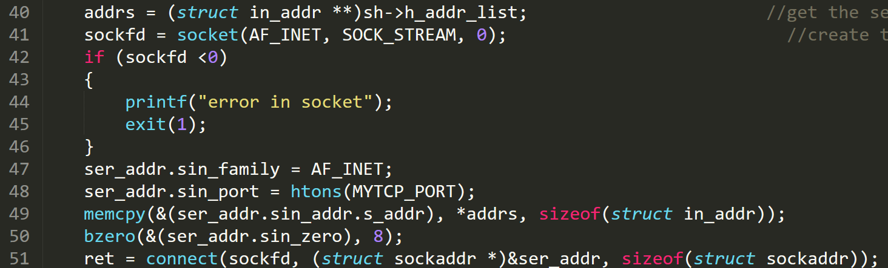
Example 1 (TCP): Client
Server address (from command line)
Creating a socket and connecting to it
Notes:
Connect: It is called by the client to connect to the server.
Listen: It is used by the server side to wait for any connection request from the client side.
Accept: This function synchronously extracts the first pending connection request from the
connection request queue of the listening socket and then creates and returns a new socket.
Sends data in a connected socket.
Receives data in a connected socket.

Slide 26
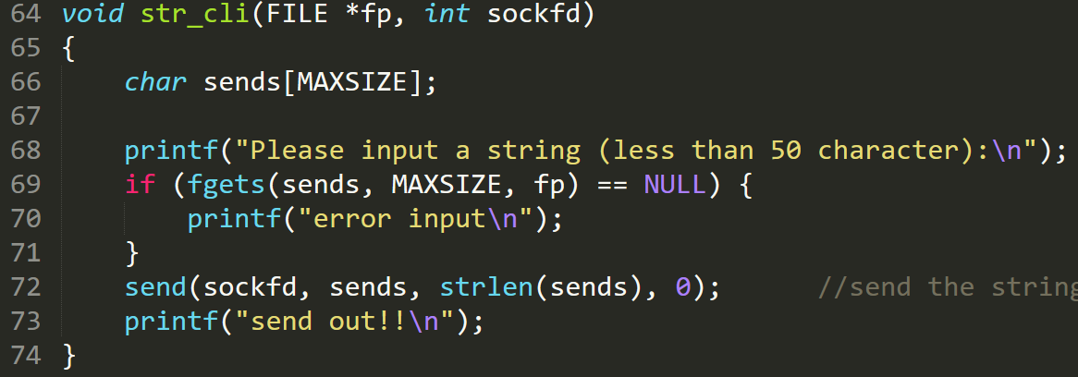
Example 1 (TCP): Client
Client application to send a string to the server

Slide 27
TCP
server
client
Create socket
Bind
Listen
Accept
Receive
Create socket
Connect
Send

Slide 28
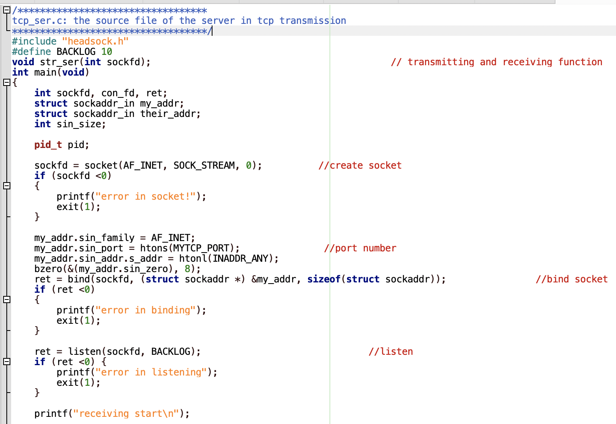
Notes:
parameter backlog is the number of connections allowed on the incoming queue.
Each incoming connections is placed in this queue until a matching accept() is issued by the server side.

Slide 29
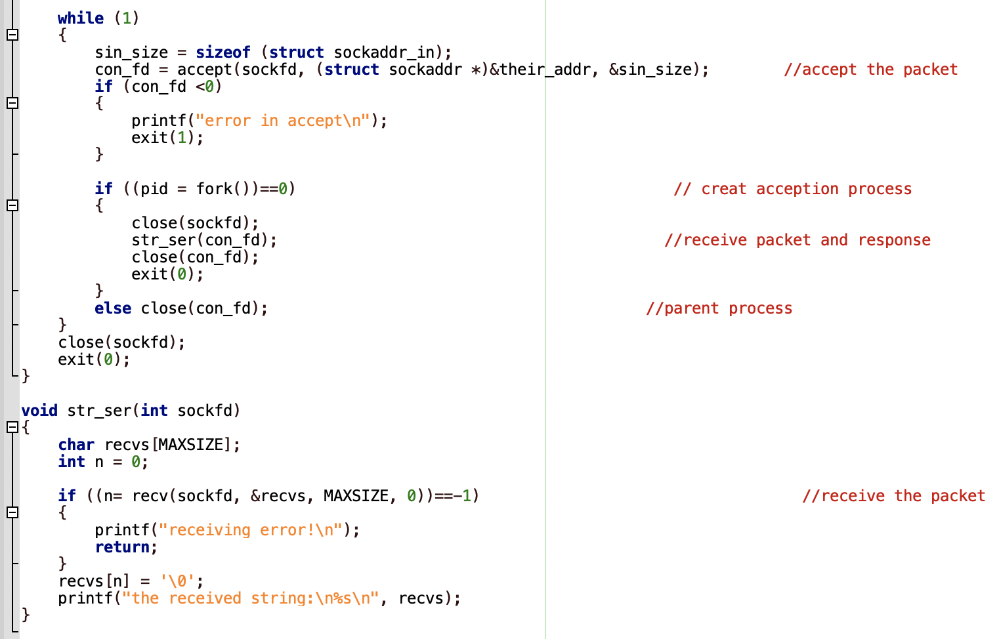
Notes:
Each incoming connections is placed in this queue until a matching accept() is issued by the server side.
the accept() call is used to remove one request from the queue.

Slide 30
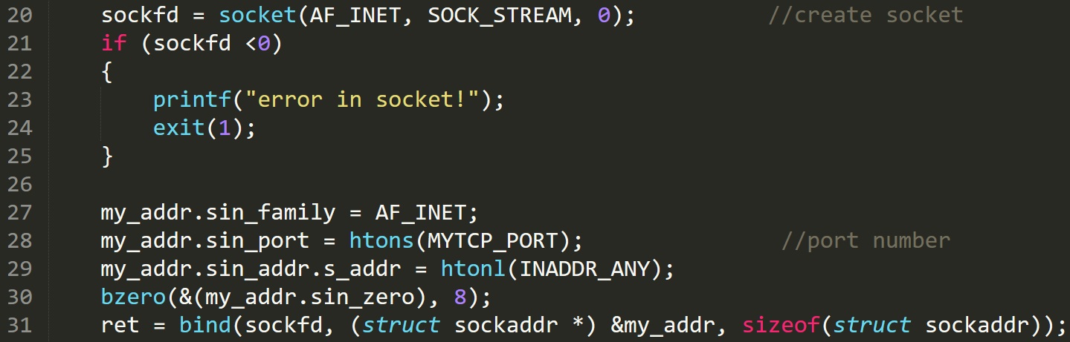
Example 1 (TCP): Server
Create a socket and bind at the server

Slide 31
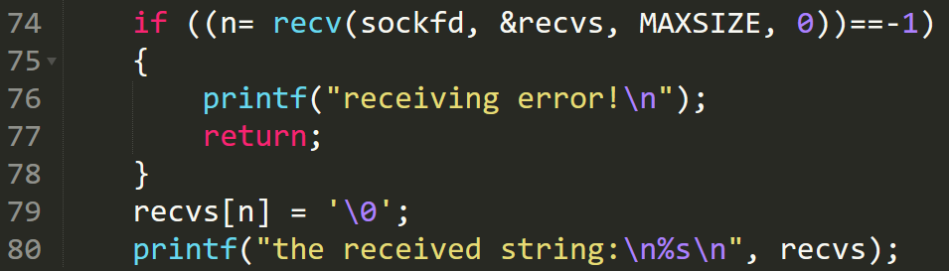
Example 1 (TCP): Server
Informs the OS, that socket is ready for requests (listen)
Connect to an incoming request (accept)
Server application to receive a string from a client

Slide 32
Example 2
Develop a TCP-based client-server socket program for transferring a large message. Here, the message transmitted from the client to server is read from a large file. The entire message is sent by the client as a single data-unit. After receiving the file, the server sends an ACK message to the receiver. Verify if the file has been sent completely and correctly by comparing the received file with the original file (“diff” command could be used). Measure the message transfer time and throughput.

Slide 33
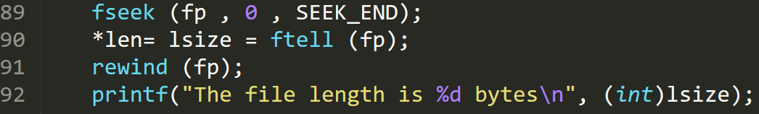
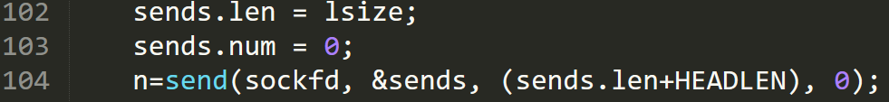
Example 2: Client
The TCP connection process is same as Example 1
Open the file in read mode
Determine the length of the file
Read the file into the buffer
Send the file to the server

Slide 34
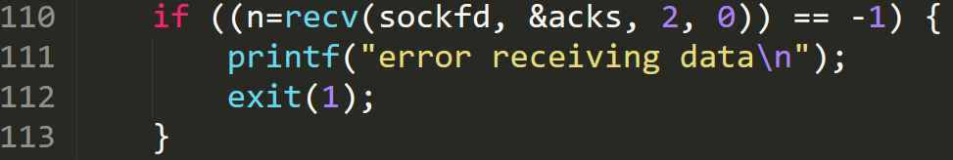
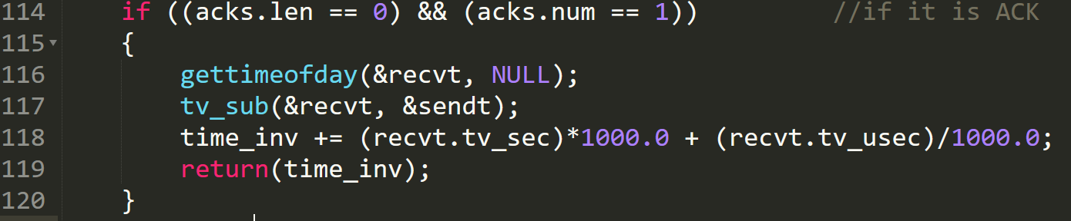
Example 2: Client
Wait for the ack
Check if it is an Ack and calculate the time taken

Slide 35
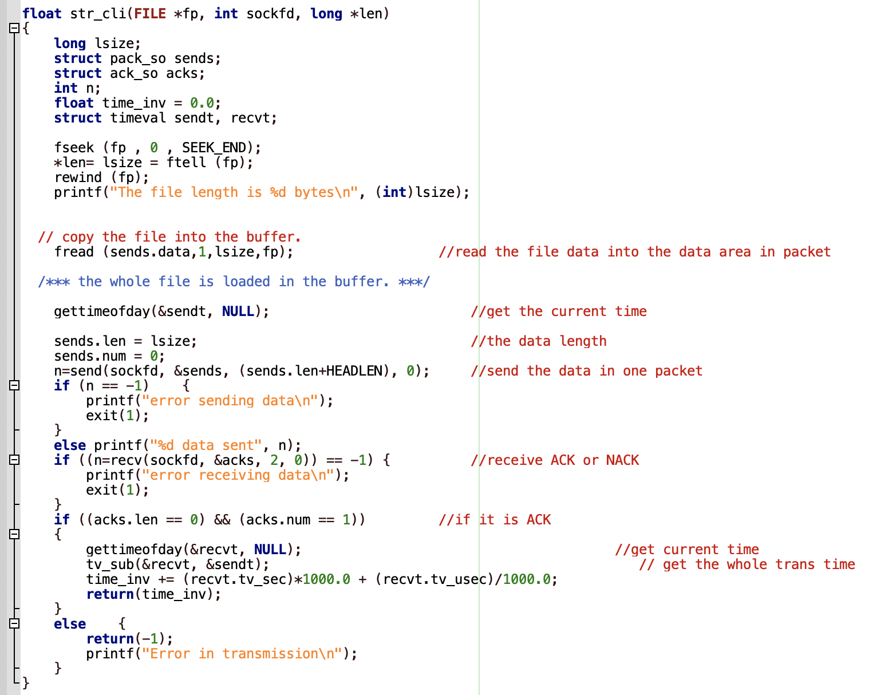

Slide 36
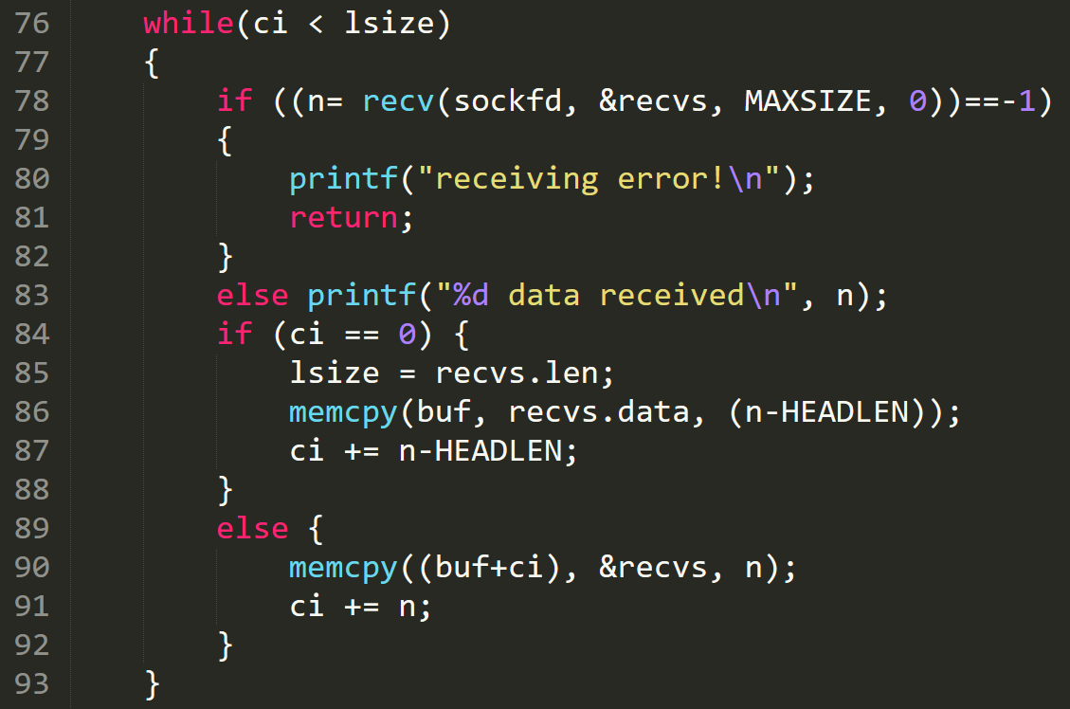
Example 2: Server
Receive the whole file from client

Slide 37
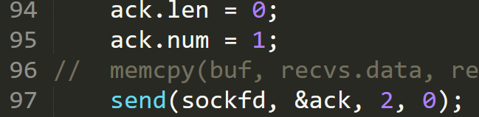
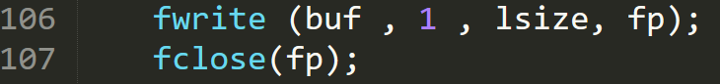
Example 2: Server
Send ack to client after receiving the whole file
Save the file from buffer to a file

Slide 38
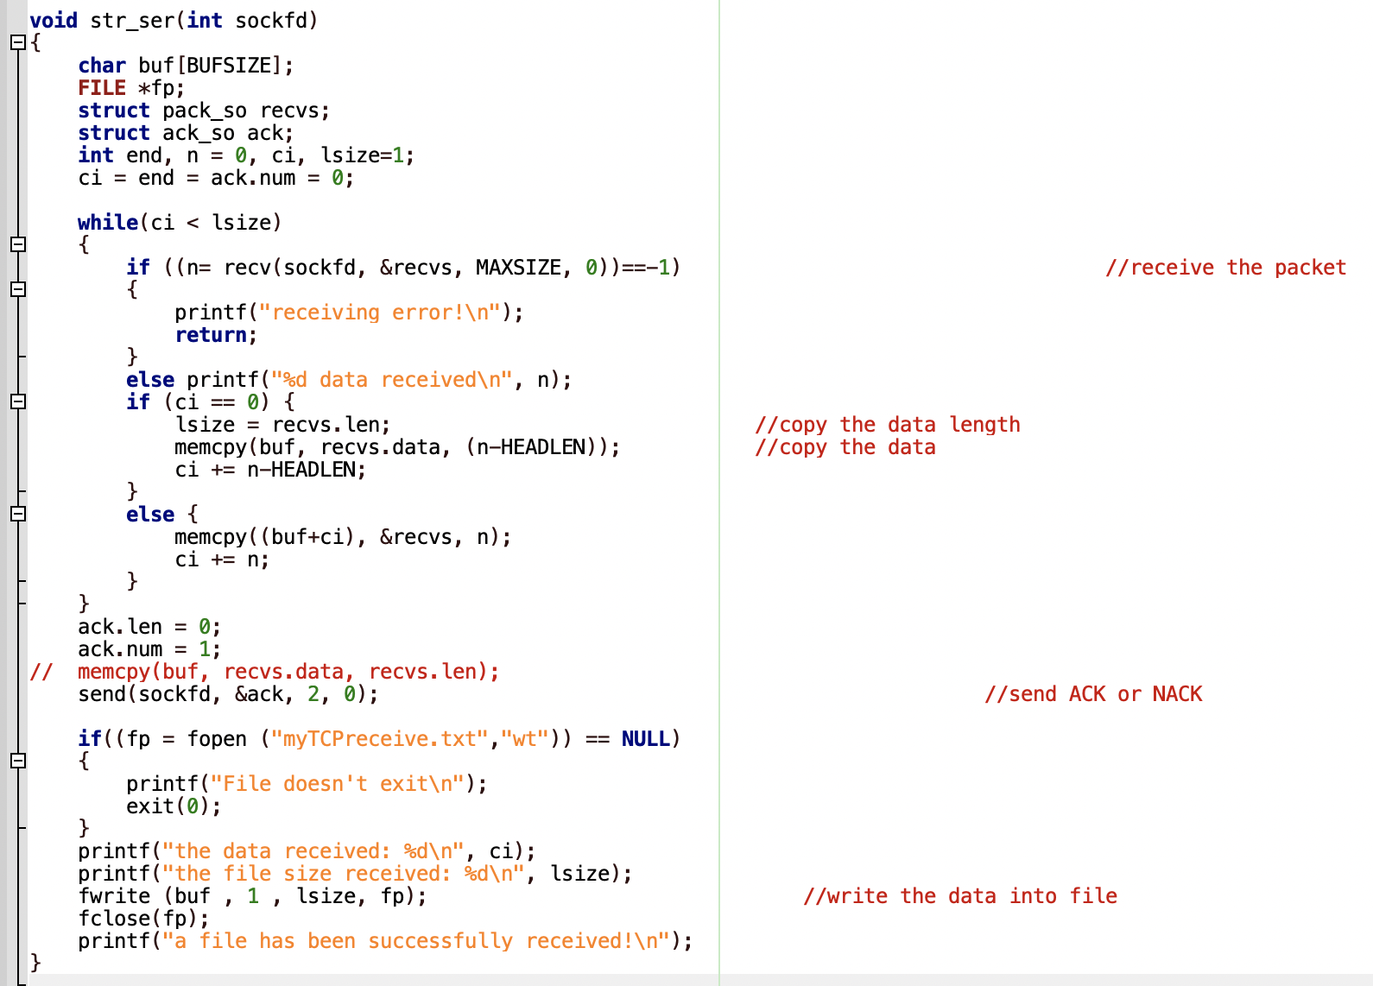

Slide 39
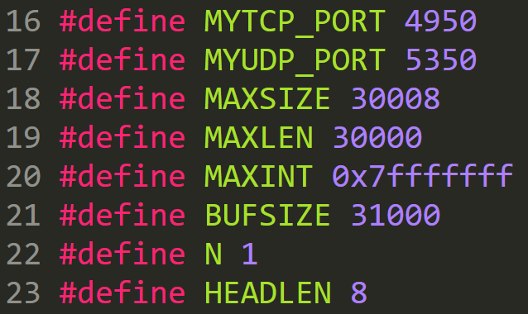
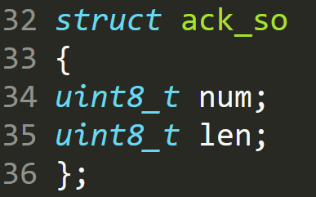
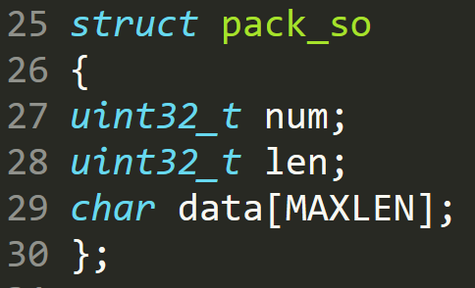
headsock.h (Ex 2)

Slide 40
Example 3
Develop a TCP-based client-server socket program for transferring a large message. Here, the message transmitted from the client to server is read from a large file. The message is split into short data-units which are sent one by one without waiting for any acknowledgement between transmissions of two successive data-units. Verify if the file has been sent completely and correctly by comparing the received file with the original file. Measure the message transfer time and throughput for various sizes of data-units.

Slide 41
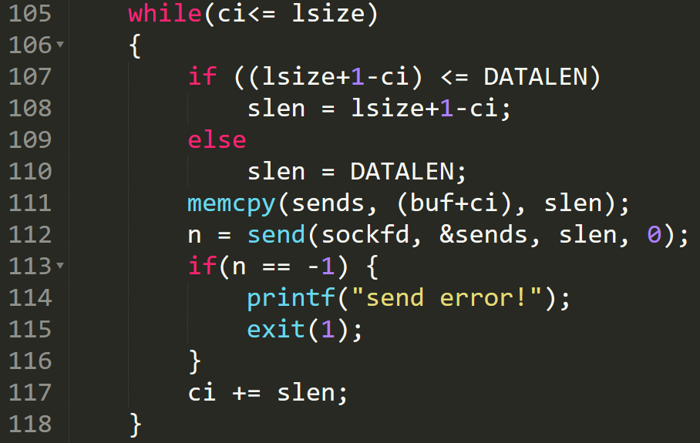
Example 3: Client sending file in data units
Sending file in data units of size DATALEN

Slide 42
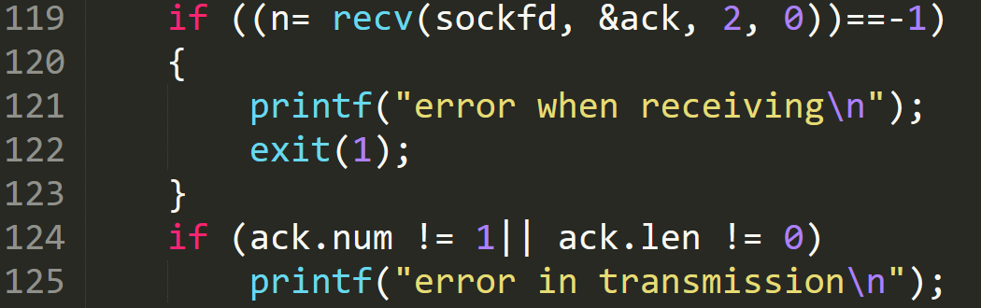
Client waits for Ack

Slide 43
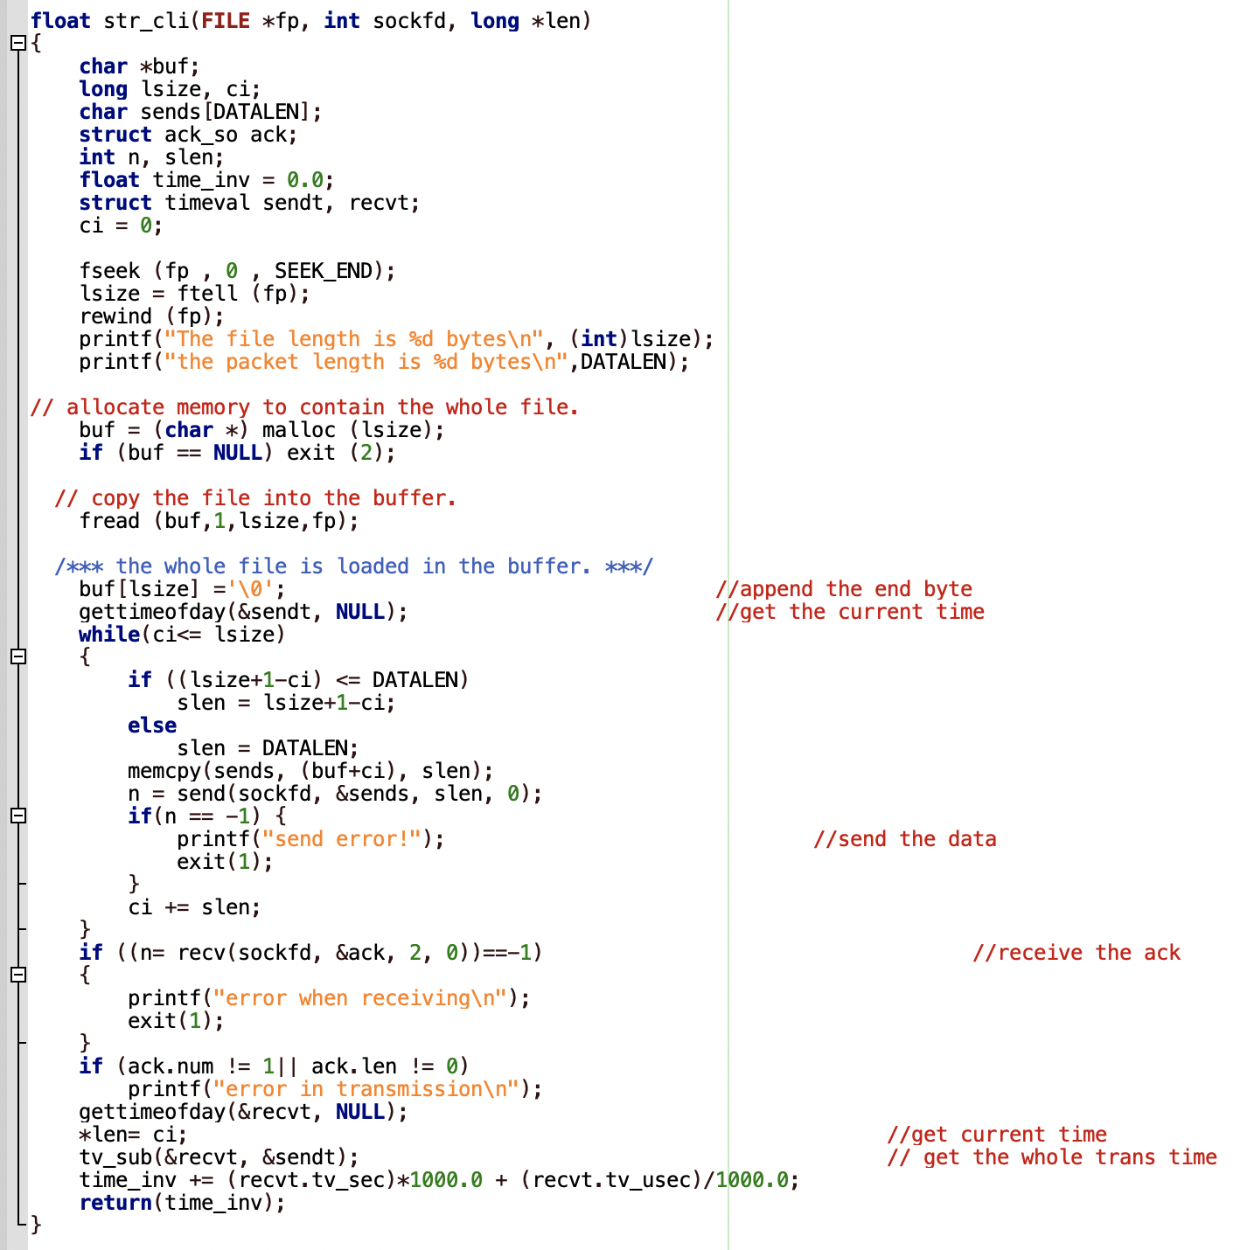

Slide 44
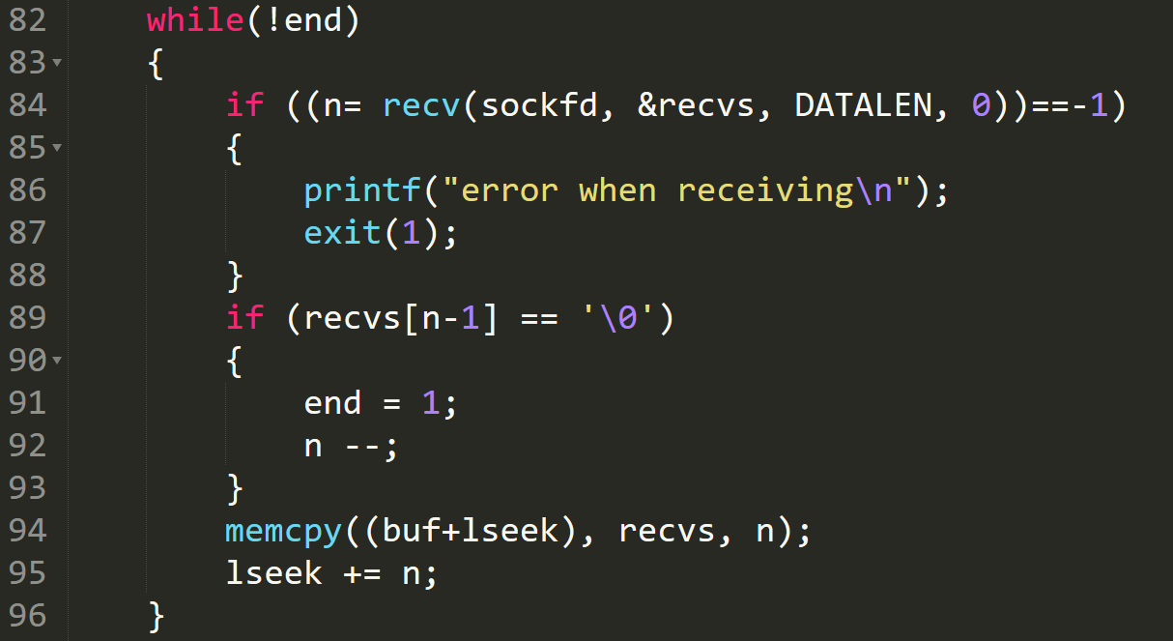
Example 3: Server receiving file in data units
Receiving file in data units of size DATALEN

Slide 45
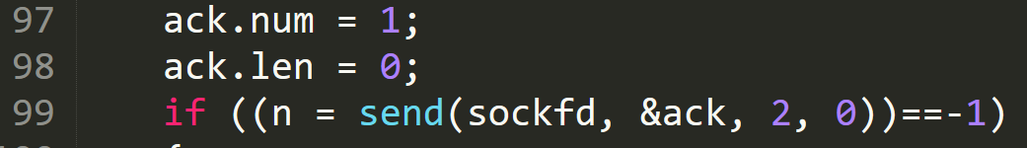
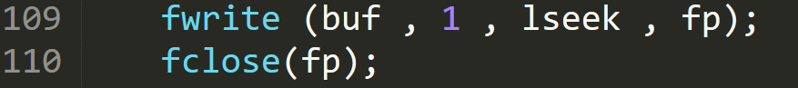
Server sending Ack and saving the file
Send ack to client
Save the file from buffer to a file

Slide 46
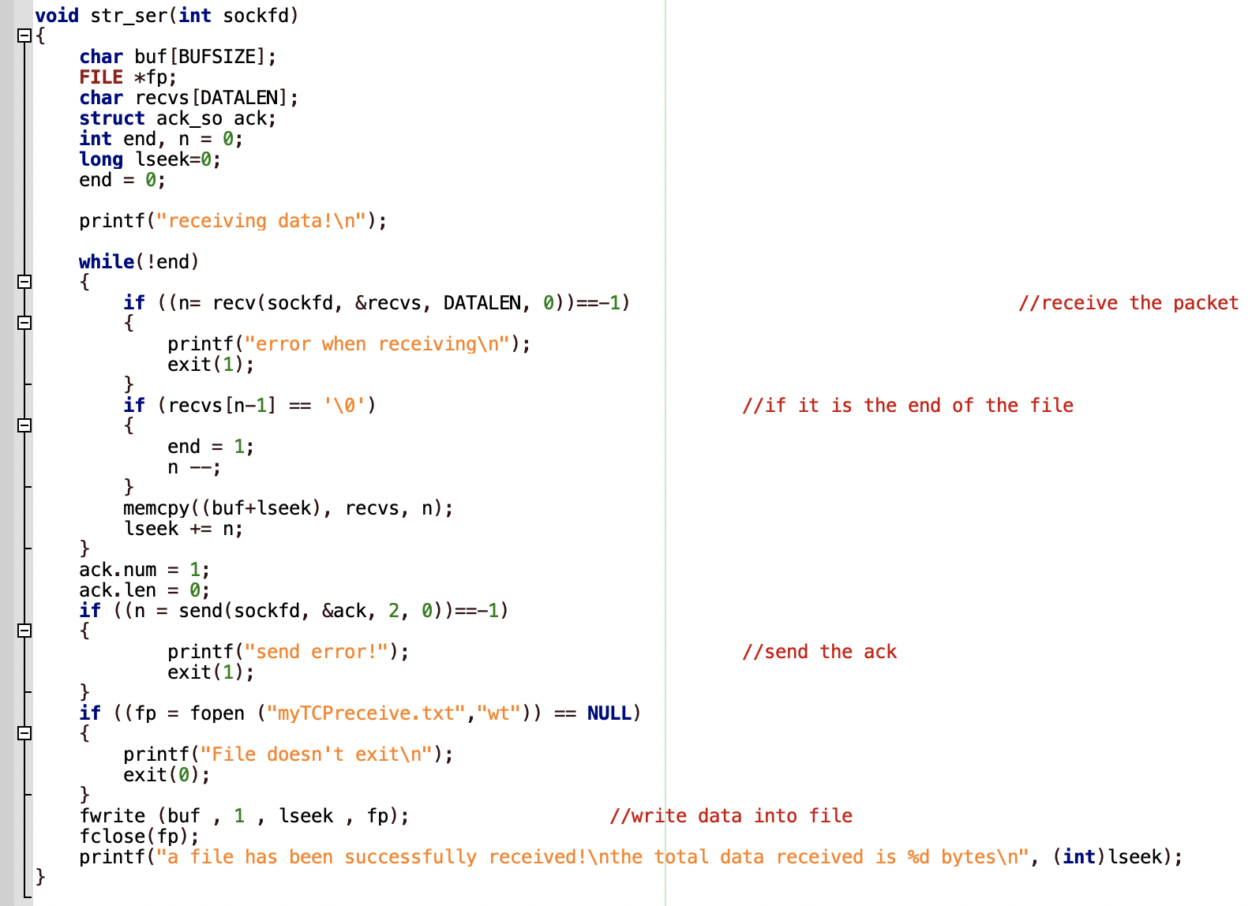

Slide 47
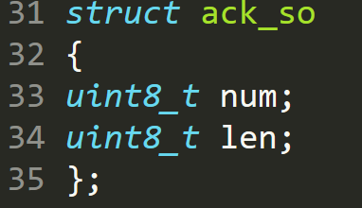
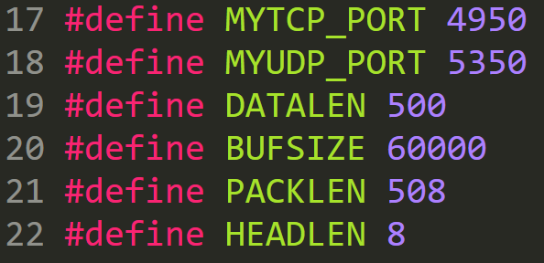
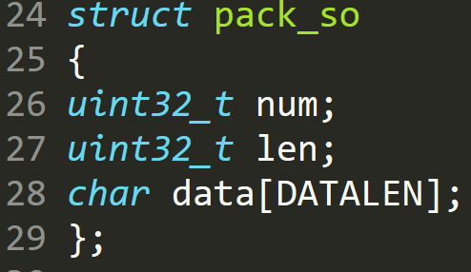
headsock.h (Ex 3)

Slide 48
Lets try examples
Server
client
Run the code
gcc tcp_ser1.c –o ser
Start Server
./ser
Run the code
gcc tcp_client1.c –o client
Start Server
./client 127.0.0.1
Note:
127.0.0.1 is a loopback IP.
To find IP address of any device, use command ‘ifconfig’

Slide 49
Example 1
Develop a socket program in UNIX/Linux that uses (i) TCP as the transport protocol and (ii) UDP as the transport protocol for transferring a short message between a client and server. The client sends a string (input by the user) to the server and the server prints the string on the screen after receiving it.
Notes:
TCP- connection oriented, slow, reliable
UDP- connectionless, faster, unreliable

Slide 50
Lets try example 1
You are encouraged to use the Ubuntu with VirtualBox
You can also use other language, OS
File transfer
VirtualBox Guest Additions
Download from LumiNUS

Slide 51
Example 2
Develop a TCP-based client-server socket program for transferring a large message. Here, the message transmitted from the client to server is read from a large file. The entire message is sent by the client as a single data-unit. After receiving the file, the server sends an ACK message to the receiver. Verify if the file has been sent completely and correctly by comparing the received file with the original file (“diff” command could be used). Measure the message transfer time and throughput.

Slide 52
Example 3
Develop a TCP-based client-server socket program for transferring a large message. Here, the message transmitted from the client to server is read from a large file. The message is split into short data-units which are sent one by one without waiting for any acknowledgement between transmissions of two successive data-units. Verify if the file has been sent completely and correctly by comparing the received file with the original file. Measure the message transfer time and throughput for various sizes of data-units.

Slide 53
Assignment Problem
[Jumping Window Protocol]: Develop a UDP-based client-server socket program for transferring a large message using a hypothetical jumping window protocol. Here, the message transmitted from the client to server is read from a large file. The message is split into short data-units (DUs) which are sent and acknowledged in batches of size n. The sender sends n DUs and then waits for an ACK before sending the next batch of n DUs. It repeats the above procedure until the entire file is sent and the acknowledgement for the last batch is received. The receiver sends an ACK after receiving n DUs. It repeats the above procedure, until the acknowledgement for the last batch is sent. Note that the last batch may have less than n DUs.

Slide 54
Assignment Problem
Verify if the file has been sent completely and correctly by comparing the received file with the original file.
Measure the message transfer time and throughput for various sizes of data-units.
Choose appropriate values for “data unit size” and measure the performance. Repeat the experiment several times and plot the average values in a report with a brief description of results, assumptions made.

Slide 55
Assignment Problem
Carry out the above experiments for three different batch size values: n=1, n=2, and n=4. Note that when n=1, this jumping window protocol becomes similar to the stop- and-wait protocol. Include the following two performance figures in your report:
a. Transfer time vs data unit size ( with three curves one each for n=1, n=2, and n=4)
b. Throughput vs data unit size ( with three curves one each for n=1, n=2, and n=4 )

Slide 56
Client
Server
1st curve
n=1
Wait for 1 packet then send ’ack’
2nd curve
n=2
Wait for 2 packet then send ’ack’
3rd curve
n=4
Wait for 4 packet then send ’ack’

Slide 57
Assessment
Date: Week 13, the exact time will be released later
Demo will be done one by one
Criteria
Date transfer: Make sure the program is ready to run
Understanding of basic socket programming: Basic steps for establishing UDP-based
Implementation of the flow control
Selection of parameter values

Slide 58
Assessment
Performance trend of the experiment results
Interpretation of the performance trend
What you need to do before the demo
Run your programs and tabulate/plot the performance results offline
Prepare a short report including your data and performance trend
The report will not be graded, which is just a supporting material

Slide 59
Assessment
During the demo
Run program
Go through your code and explain the logic
Show the report of data and performance trend figures
Answer questions by GA, if any
The marks are only based on the demo session!

